Slide 1
Escaping a Corn Maze: as seen in the media
Arup Guha
dmarino@cs.ucf.edu
4/18/2015

Slide 2
Corn Mazes
Real life set up where humans get to see what it’s like to be a lab rat!
At different junctures, choices can be made about what direction to go.
Goal: to get out!!!
http://abcnews.go.com/US/people-lost-worlds-biggest-corn-maze-called-911/story?id=26868458

Slide 3
How can Computer Science help?
Computer Scientists study algorithms.
Algorithms are methods to solve problems.
A common problem in many problem domains is systematically searching for an item in some search space.
One algorithm used to search for locations, where pairs of locations are connected with roads (or dirt paths) is called breadth first search.

Slide 4
What is a breadth first search(BFS)?
We are given a road map, a starting location and a desired destination.
Our goal is to travel to each possible reachable location from our starting location, marking where we’ve been.
If we ever get to our destination, our search was a success!!!

Slide 5
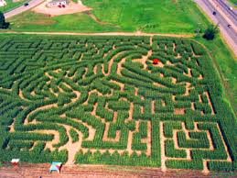
Key Issues
How do we determine if we’ve been somewhere before?
How do we determine which roads to travel from? There seem to be lots of choices!!!

Slide 6

Key Data Structure: Queue
Queue is the British word for “line”.
First In, First Out
If you get in line before me, you get to check out before me.
Supported Operations
Enqueue (when you get to the line, you go to the back)
Dequeue (the person to check out is the one at the front)

Slide 7
Role of a Queue in a BFS
Our queue will keep track of the locations from which we explore, in the order that we want to explore from them.
We must never add an item into the queue more than once, since that would make us explore redundant paths.
Once we run out of places to explore from, our exploration is done and we have gone to all of the places that we can possibly reach from our original starting point.

Slide 8
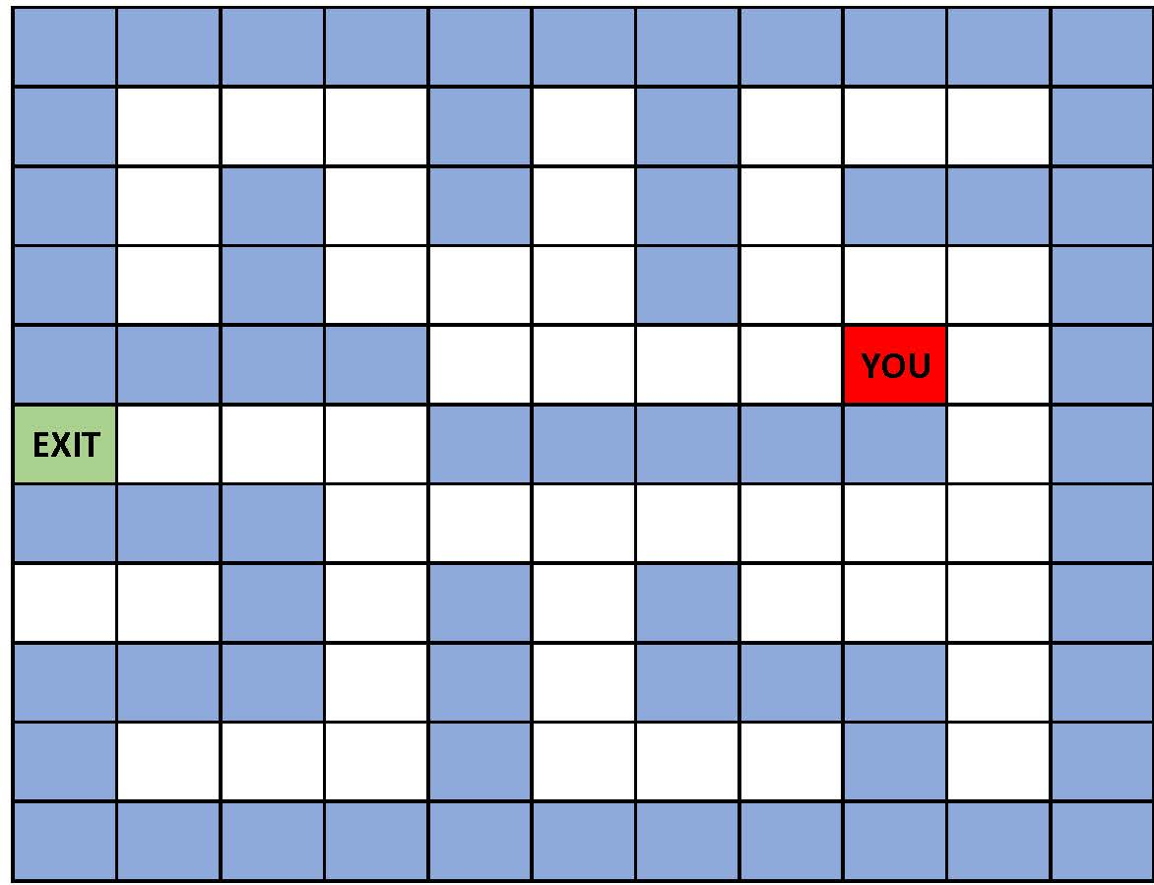
A Sample Maze

Slide 9
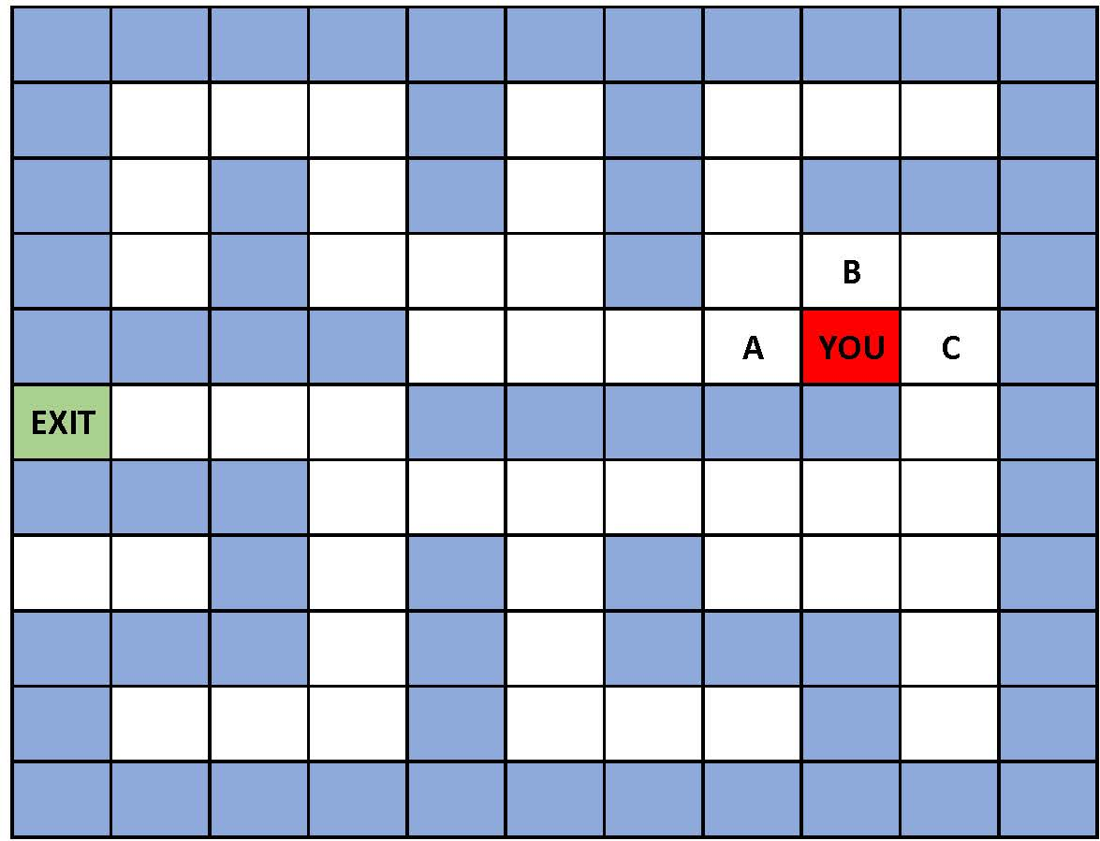
First Enqueues
Visited: YOU, A, B, C
Queue: A, B, C

Slide 10
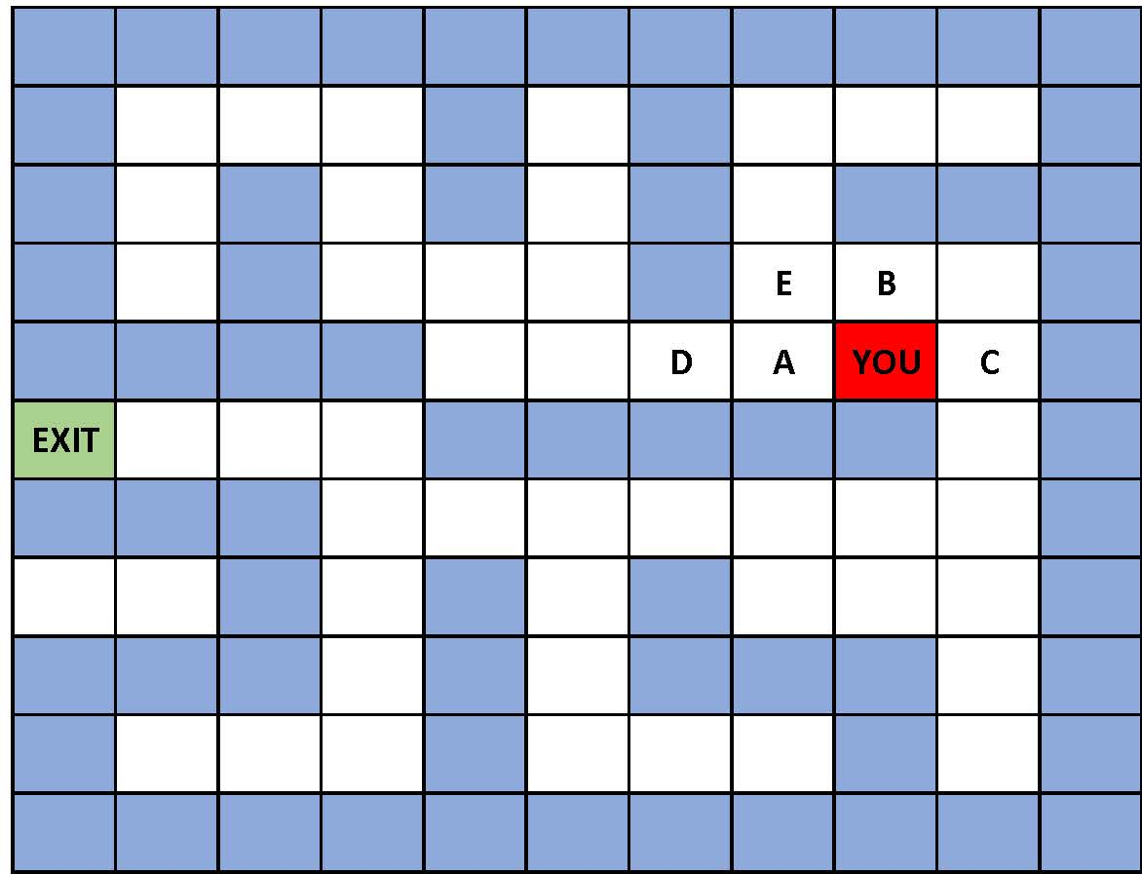
Next Steps
Visited: You, A, B, C, D, E
Queue: B, C, D, E

Slide 11
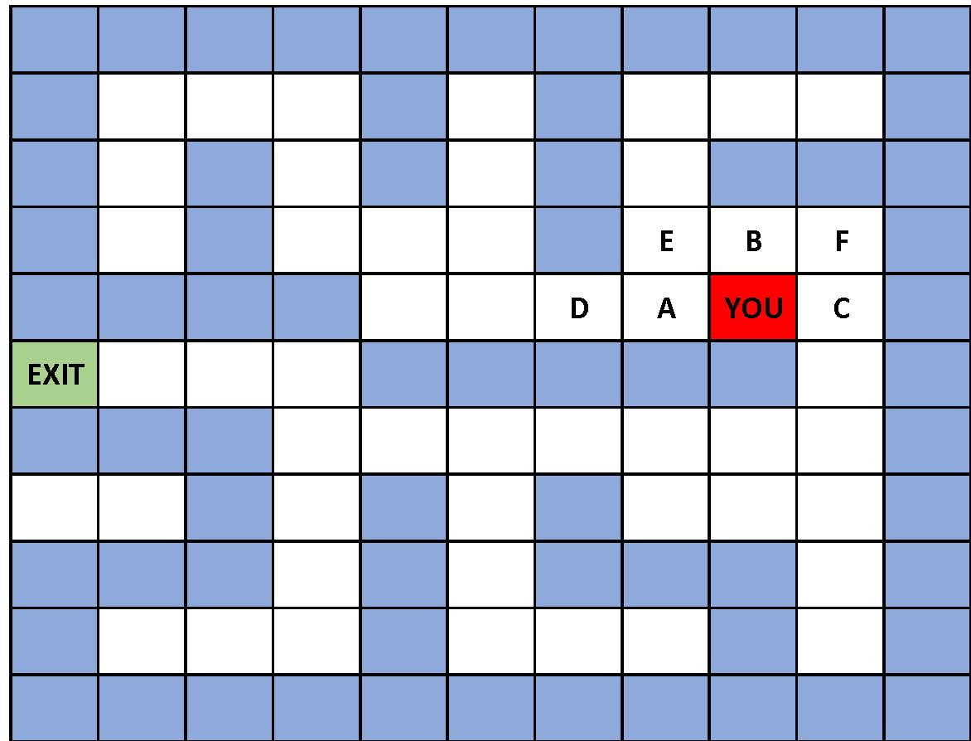
Next Steps
Visited: You, A, B, C, D, E, F
Queue: C, D, E, F

Slide 12
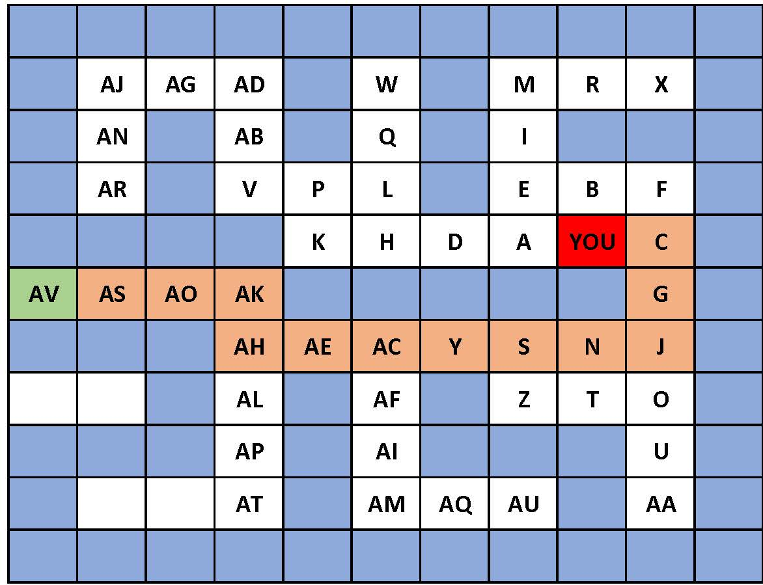
Algorithm Conclusion
Nodes are visited in alphabetical order, by single letter, then double letter.
Final shortest path can be traced by following every relevant enqueue.

Slide 13
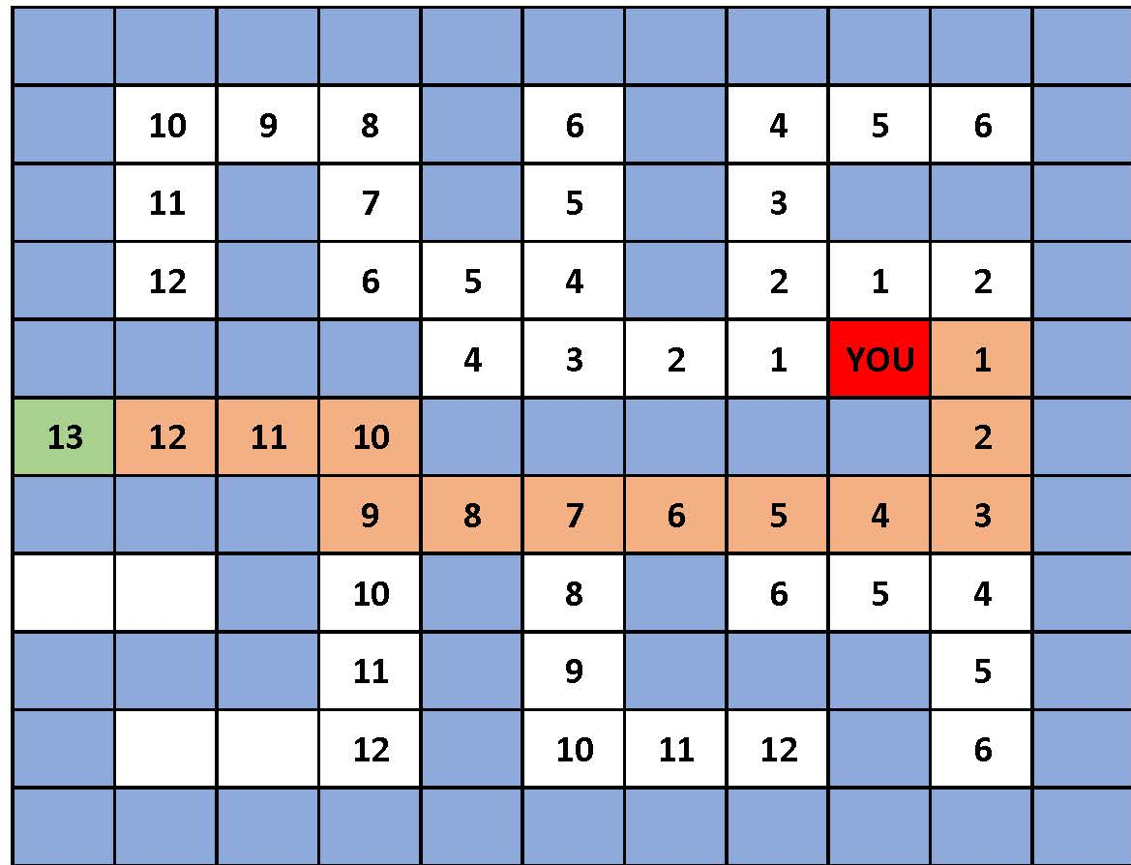
Algorithm By Product – Shortest Distances
We can easily calculate all shortest distances!
When we enqueue an item, its distance from the start is one more than the node “who” enqueued it.

Slide 14
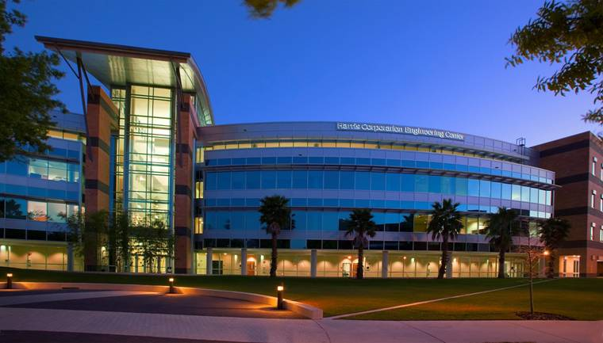
Thank You! Any Questions?
Mr. Arup Guha, dmarino@cs.ucf.edu, HEC-240

